Slide 1
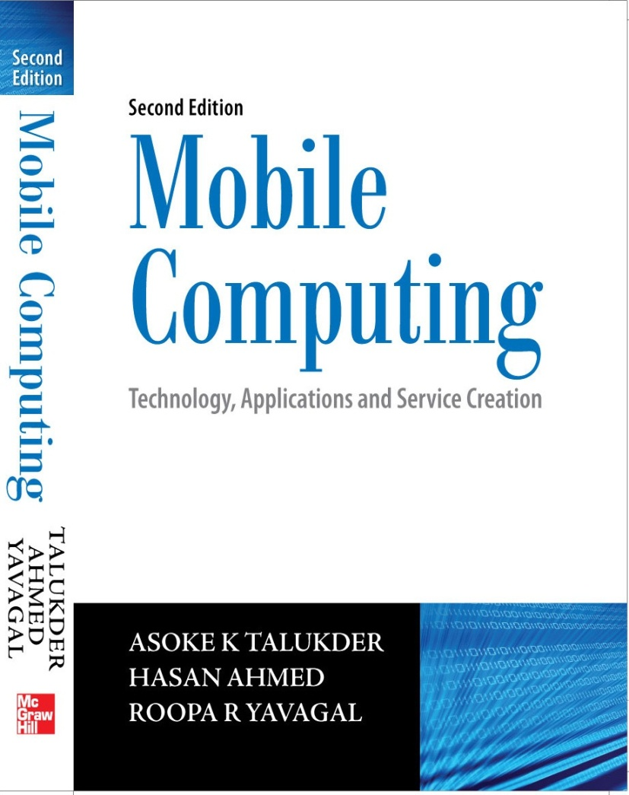
Notes#9
Wireless Application Protocol

Slide 2
Wireless Application Protocol (WAP)
Wireless Application Protocol was designed for access to Internet and advanced telephony services from mobile phones
Pays intelligent sensitivity to the constraints of these devices like small display, limited keys on the keypad, no pointer device like mouse, etc.

Slide 3
Evolution of WAP
DoCoMo of Japan developed a language called compact Hyper Text Markup Language (cHTML) and a gateway which can be used for accessing the Internet.
Unwired Planet of USA developed a comprehensive framework including browser, gateway and markup language. The markup language was called Handheld Device Markup Language (HDML) and the protocol was called Handheld Device Transport Protocol (HDTP).
Ericsson of Europe developed Intelligent Terminal Transfer Protocol (ITTP) with the intent of making it easy for call control and adding services to mobile telephony platforms.

Slide 4
Evolution of WAP
Nokia developed the Tagged Text Mark-up Language (TTML) which allowed a mobile phone to communicate with a World Wide Web site via gateway. Following TTML, Nokia introduced Narrow Band Sockets (NBS) to create wireless messaging applications for PCs communicating with GSM phones.
Ericsson, Motorola, Nokia, and Unwired Planet joined hands to launch the WAP Forum which is now known as Open Mobile Alliance.
The goal of WAP Forum was to produce a refined, license-free protocol, independent of the underlying air-link standard and it inherited its main characteristics and functionality from HDML, HDTP, Smart Messaging specification based on TTML, ITTP and NBS.

Slide 5
Networks for WAP
All GSM modes
GPRS
CDMA IS-95 and cdma2000
TDMA IS-136
i-mode
3G systems: IMT-2000, UMTS, W-CDMA and Wideband IS-95

Slide 6
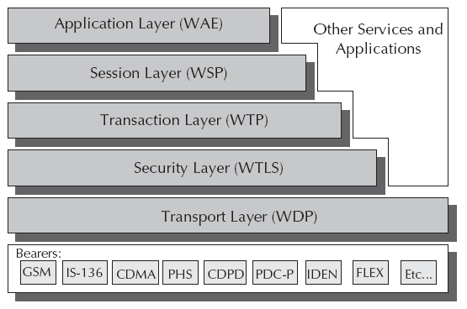
Architecture of WAP

Slide 7
Components of WAE
User agent which is the browser or a client program
Wireless Markup Language (WML) which is a lightweight markup language optimized for use in wireless devices
WMLScript which is a lightweight client side scripting language
Wireless Telephony Application
WAP Push Architecture which allow for mechanisms to allow origin servers to deliver content to the terminal without the terminal requesting for it

Slide 8
WAE
Primary objective of WAE is to provide an interoperable environment to build services in wireless space
Content is transported using standard protocols in the WWW domain and an optimized HTTP like protocol in the wireless domain
WAE architecture allows all content and services to be hosted on standard Web servers when all content is located using WWW standard URLs
WAE enhances some of the WWW standards to reflect some of the telephony network characteristics

Slide 9
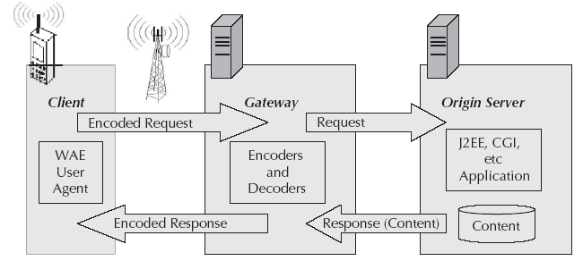
Architecture of WAE

Slide 10
User Agent
User Agent is the user facing browser software, while in WAE this is generally referred to as micro-browser.
WAE only defines fundamental services and formats that are needed to ensure interoperability among implementations and different layers.
User Agent Profile (UAProf) specification allows WAP to notify the content server about the device capability.
Devices that support UAProf architecture provide a URL in the WAP or HTTP session header which points to a XML file that describes the profile of that device which is used to deliver the content to best suit the terminal’s capabilities.

Slide 11
WML
Wireless Markup Language
Tag based document manipulation language which shares a heritage with HTML and HDML.
WML is designed to specify presentation and user interaction on mobile phones and other wireless devices.
WML implements a deck and card metaphor. A deck is a logical representation of a document and made up of multiple cards. Each WML card, in a deck, performs a specific task for a particular user interaction.
To access a document, a user navigates to a card; reviews its contents, makes a choice or enters requested information and then moves to another card.

Slide 12
WML
WML has support for:
Text
User input
Task invocation control
Universal character support
MMI independence
Narrow band optimization
State and context management

Slide 13
WML
All WML tags are case sensitive and must be properly closed.
Cards within a deck can be related to each other with links
A card element can contain text, input fields, links, images, etc.
When a WML page is accessed from a mobile phone, all the cards in the page are downloaded from the WAP server.
Navigation between the cards is done inside the phone without any extra access trips to the server.

Slide 14
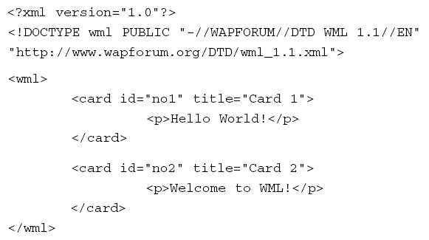
WML
Example code of printing “Hello World!” in WML

Slide 15
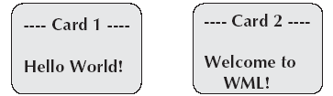
WML
Output of the previous code

Slide 16
WML Script
Extended subset of JavaScript and forms a standard means for adding procedural logic to WML decks
Used to do client side processing and can be used very effectively to add intelligence to the client and enhance the user interface
Using WML Script, it is possible to access the device resources and provides the application programmer with a variety of interesting capabilities

Slide 17
WML Script
Provides ability to do local validation of user input before it is sent to the content server
Provides ability to access device resources, functions and peripherals
Provides ability to interact with the user without reference to the origin server
Other features include:
JavaScript based scripting language
Procedural Logic
Compiled implementation

Slide 18
WML Script
Event based
Integrated into WAE
International support
Efficient extensible library support
Data types

Slide 19
WTAI
Wireless Telephony Application Interface
WTAI function libraries are accessed from server side using URL’s; or at the client side through WML Script
Different library functions to do different telephony functions like Voice Call Control, Network Text, Phonebook and Call Logs

Slide 20
WAP Push Architecture
In Pull technology, client pulls information from the server.
Push technology is based on the client/server model but there is no explicit request from the client before the server transmits its content. This can be termed as unsolicited response.
‘Pull’ transactions are always initiated from the client whereas ‘Push’ transactions are server initiated.
Push technology is helpful to implement alerts and notification.

Slide 21
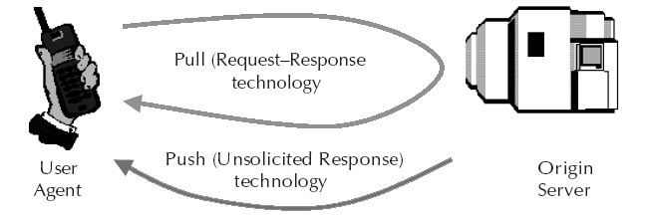
Pull v Push Technology

Slide 22
Push Framework
Push content is originated in a server in the Internet that needs to be delivered to a mobile phone while Push Initiator contacts the Push Proxy Gateway (PPG) from the Internet side delivering content for the destination client.
PPG then forwards the content to the mobile network to be delivered to the destination client over the air. PPG is, also, capable of notifying the Push Initiator about the final outcome of the push operation. It may even wait for the client to accept or reject the content in two way mobile networks.
Internet side PPG access protocol is called the Push Access Protocol while WAP side protocol is called the Push Over The Air Protocol.

Slide 23
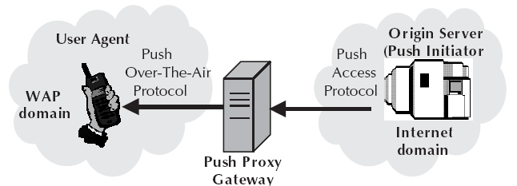
Push Framework with PPG

Slide 24
WSP
Wireless Session Protocol
Provides a consistent interface between two session services (like client and server)
Provides the cooperating client/server applications to establish a reliable session from client to server and close it in an orderly manner, agree on a common level of protocol functionality using capability negotiation and exchange content between client and server using compact coding
WSP helps suspend and resume the session

Slide 25
WSP
It offers both connection oriented and connectionless service while connectionless service is most suitable when applications do not need reliable delivery of data and do not care about confirmation.
Connection oriented session services are divided into Session Management facility, Method Invocation facility, Exception Reporting facility, Push facility, Confirmed Push facility and Session Resume facility.
Designed to function on the transaction and datagram services between WAE and the WTP and as such WSP itself does not require a security layer.

Slide 26
WTP
Wireless Transaction Protocol
Runs on top of a datagram service and provides a lightweight transaction oriented protocol that is suitable for implementation in thin clients while employing asynchronous transactions
Allows for interactive browsing (request/response) applications and supports three transaction classes: unreliable with no result message, reliable with no result message and reliable with one reliable result message
Optional user to user reliability and optional out-of-band data on acknowledgements
PDU concatenation and delayed acknowledgements to reduce the number of messages sent

Slide 27
WTLS
Wireless Transport Layer Security
Security protocol based upon the Transport Layer Security (TLS) protocol
Intended for use with the WAP transport protocols and has been optimized for use over narrow band communication channels
Provides support for:
Data Integrity
Privacy
Authentication
Denial of service protection

Slide 28
WDP
Wireless Datagram Protocol
Transport layer protocol in the WAP architecture
Operates above the data capable bearer services supported by the various network type general transport service
Offers a consistent service to the upper layer protocols of WAP and communicates transparently over one of the available bearer services
Uses User Datagram Protocol (UDP)
By keeping the transport layer and the basic features consistent, global interoperability can be achieved using mediating gateways

Slide 29
WAP Gateway
Acts as a middleware which performs coding and encoding between cellular device and the web server
Can be located either in a telecom network or within a computer data network (ISP)
Implements a WAP protocol stack
Does protocol translation between phone and server
Compresses WML pages to save bandwidth
Does user authentication and billing

Slide 30
WAP Gateway
External interfaces of WAP gateways are:
SMS center using various protocols
HTTP servers to fetch WML pages
WAP devices using WAP protocol stack
Keeps the number of packets small to keep costs down and make the best use of available bandwidth
May include the charging function

Slide 31
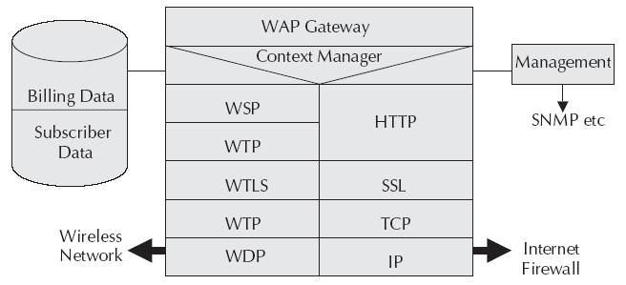
Architecture of WAP Gateway

Slide 32
MMS
Multimedia Messaging Service
Can contain formatted text, graphics, data, animations, images, audio clips, voice transmissions and video sequences
Two standards bodies producing specifications relating to MMS messages: WAP Forum and the 3GPP
Standards from the WAP Forum specify how messages are composed and packaged whereas standards from the 3GPP specify how messages are sent, routed and received
Layout and ordering of the slides are specified through a language called Synchronization Multimedia Integration Language (SMIL)

Slide 33
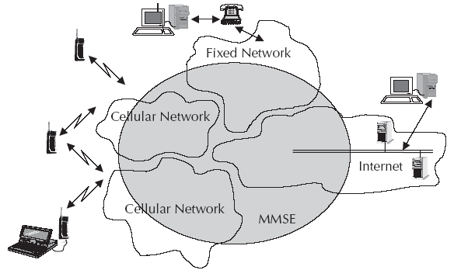
MMS in different networks
MMSE – MMS Environment

Slide 34
Architecture of MMS
Multimedia Message Service Environment (MMSE) encompasses various elements required to deliver a MMS and includes:
MMS Client - This is the entity that interacts with the user. It is an application on the user’s wireless device.
MMS Relay - This is the system element that the MMS client interacts with. It provides access to the components that provide message storage services. It is responsible for messaging activities with other available messaging systems. The SMS relay along with the MMS content server is referred to as MMS Controller (MMSC).

Slide 35
Architecture of MMS
WAP Gateway - It provides standard WAP services needed to implement MMS.
MMS Server - This is the content server where the MMS content is generated.
Email Server - MMS can integrate seamlessly to the email system of Internet.
Messages that transit between the MMS Client and MMS Relay pass through WAP Gateway. Data is transferred between the MMS client and WAP gateway using WAP Session Protocol (WSP). Data is transferred between the WAP gateway and the MMS Relay using HTTP.

Slide 36
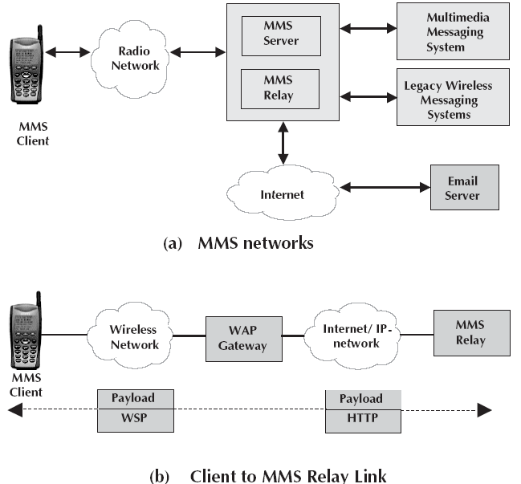
MMS Environment

Slide 37
MMS Transactions Flows
MMS service is realized by the invocation of transactions between the MMS Client and the MMS Relay.
General transactions of sending and retrieving messages do not depend on what type of client the message is sent to or MMS service is realized by the invocation of transactions between the MMS Client and the MMS Relay.
The general transactions of sending and retrieving messages do not depend on what type of client the message is sent to or received from. The other endpoint for the message may be another MMS Client or a client on a legacy wireless messaging system or it may even be an email server.

Slide 38
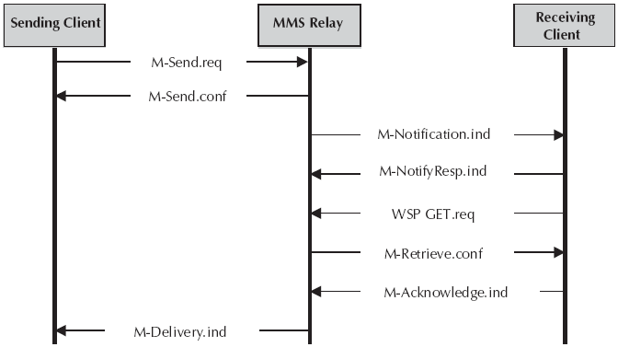
MMS Transaction Flows

Slide 39
SMIL
Synchronized Multimedia Integration Language
XML based language specified by the W3C for specifying how and when multimedia clips will play
Integrates streaming audio and video with images, text or any other media type
MMS messages are sent using SMIL as the presentation language
MMS adapted a limited subset of SMIL, often referred to as ‘MMS SMIL’

Slide 40
SMIL
Links can be to various places inside the current presentation to allow the user to jump around from place to place within the timeline of the presentation
SMIL support images, text and audio

Slide 41
Interoperability and Roaming for MMS
Interoperability of MMS means the ability of terminals to exchange mutually acceptable messages between terminals from different vendors or network components like MMSCs and with WAP gateways. This includes the end-to-end exchange of formats and protocols.
MMS roaming means that a subscriber can send and receive MMS messages when roaming in another network.
Main method for GPRS roaming is PLMN roaming where the home PLMN GGSN is used while another method is ISP roaming where the visited PLMN GGSN is used.

Slide 42
Interoperability and Roaming for MMS
When the user is roaming, MMS messages are sent via normal packet data traffic between the home operator network and the roaming operator network. In addition to this, roaming customer must be able to receive SMS from the home SMSC. To achieve MMS roaming, both GPRS and SMS roaming procedures are required.
Participating operators need to have a packet data roaming agreement and SMS roaming agreement in place and operators must solve the problem of handling the interconnection charge, first within one country and then globally.
There are three ways for operators to arrange MMS: Interconnection using GPRS Roaming Exchange (GRX), VPN over Internet and VPN over leased lines.

Slide 43
Interoperability and Roaming for MMS
OMA and 3GPP have defined three domains for multimedia messages.
The first is the Core MM Content Domain where full interoperability is guaranteed.
The second is the Standard MM Content Domain where terminals and multimedia messages are still compliant with MMS standards but terminals have certain freedoms.
The third domain is the unclassified MM Content Domain giving full freedom to create multimedia messages.

Slide 44
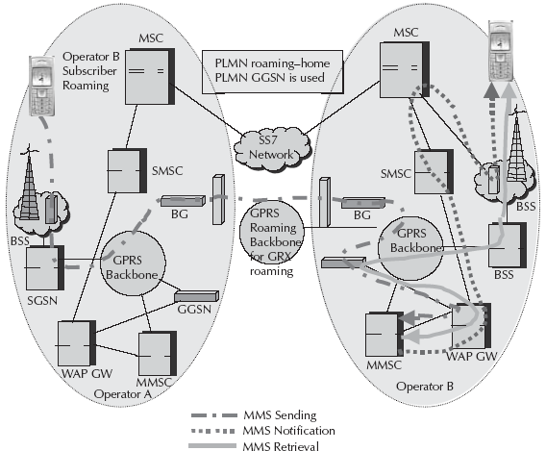
MMS Sender Roaming

Slide 45
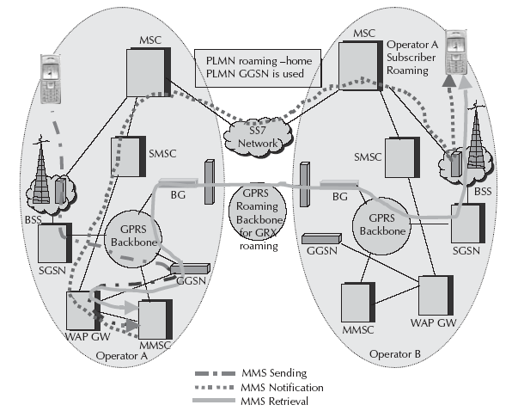
MMS Receiver Roaming

Slide 46
MMS Device Management and Configuration
MMS services require complex configuration.
There is a need to be able to configure the users’ devices by providing device settings over the air.
OMA device management architecture consists of two components: OMA Client Provisioning and a continuous management technology that is based on the SyncML Device Management specification.
Client Provisioning is a messaging based provisioning technology that sends settings over the air to the device and configure. All the user has to do is to accept the sent settings and the device will be correctly configured and ready for use.

Slide 47
GPRS Applications
MMS based contents/applications better suited for GPRS networks are:
Dating
Games
Sending/Receiving Fax/Email on the handset
Location aware applications
VPN
Multimedia downloads

Slide 48
Digital Rights Management
As services take off, it is crucial to take into account Digital Rights Management (DRM) for the distribution and consumption of mobile content.
With DRM, the content owner or service provider can determine if and how his content can be distributed if at all from person to person. Of course, some content will be available even without DRM.
All the content created by mobile users themselves will be free.
Companies involved in mobile content services such as ring tones, wallpapers, or games where the business plan is based on being able to collect the rightful payment, will be interested in implementing DRM technology.

Slide 49
OMA DRM
OMA has proposed Digital Rights Management and OMA Download standards.
By implementing OMA DRM, service providers can allow end users to preview content before making a purchase decision.
OMA DRM also allows end users to distribute content to other users via super-distribution. The OMA DRM standard will govern the use of mobile centric content types.
It provides three methods: Forward-lock, Combined delivery and Separate delivery.

Slide 50
OMA DRM
Forward-lock is intended for the delivery of subscription-based services. The device is allowed to play, display or execute the MMS but it cannot forward the MMS object. The content itself is hidden inside the DRM message that is delivered to the terminal. Examples will be news, sports, information and images that should not be sent on to others.
Combined Delivery enables usage rules to be set for the media object. This method extends Forward-lock by adding a rights object to the DRM Message. Rights define how the device is allowed to render the content and can be limited using both time and count constraints. This method allows previews.

Slide 51
OMA DRM
Separate Delivery protects higher value media and enables super-distribution. This allows the device to forward the media, but not the rights. This is achieved by delivering the media and rights via separate channels which is more secure than combined delivery. The media is encrypted into DRM Content Format (DCF) using symmetric encryption while the rights hold the Content Encryption Key (CEK), which is used by the DRM User Agent in the device for decryption. Recipients of super-distributed content must contact the content retailer to obtain rights to either preview or purchase media.

Slide 52
Next Chapter
Client Programming
Thank you

